Slide 1

NaN-Sense Solutions
GROUP 3: Lisa Bartel, Niels Zimmermann, Wadim, Juan, Maria Trokoz
Notes:
Hello everyone
For our expansion to Brazil, Magist, our potential partner, has given us
a look into their data from the past three years (from 20016-2018).
We at Eniac pride ourselves on quality and our commitment to the human
side of the business. High-end tech products and fast deliveries keep
our customers happy. So that is what our team NAN-Sense Solutions from focused on when we
analyzed the data given to us.
Based on what we found, we don’t recommend the planned three-year contract.
Magist is apparently not used to handle hight priced items.
Also the long delivery times dont meet our standards.
Our vision is clear: we want to expand. We have set our sights on the Brazilian market—one of the most dynamic economies in the world. Our business model is based on quality. We sell high-end technology, especially Apple products. We know that demand in Brazil is huge. So the plan is to bring our premium products across the Atlantic and use a local partner to scale up quickly. The goal is growth through quality.
But before we take this step, our team – ‘NAN-Sense Solutions’ – has analyzed the potential partner Magist in detail. And here we encounter a fundamental problem. Take a look at the figures: at Eniac, our average order value is €540. That's the world of iPhones and MacBooks. Magist, on the other hand, operates in a completely different reality. The average shopping cart there is only €108. So we are trying to sell luxury goods via a platform that is designed for inexpensive mass-market goods and small accessories.
This discrepancy is dangerous. Anyone who spends €1,000 on a device will not accept long delivery times and mediocre service—things that seem to be the norm at Magist. An immediate, long-term commitment would be gambling with our brand reputation. That is why our verdict today is: beware of speed. We do not recommend a 3-year contract.
Unsere Vision ist klar: Wir wollen expandieren. Wir haben den brasilianischen Markt ins Visier genommen – eine der dynamischsten Volkswirtschaften der Welt. Unser Geschäftsmodell basiert auf Qualität. Wir verkaufen High-End-Technologie, insbesondere Apple-Produkte. Wir wissen, dass die Nachfrage in Brasilien riesig ist. Der Plan ist also: Wir bringen unsere Premium-Produkte über den Atlantik und nutzen einen lokalen Partner, um schnell zu skalieren. Das Ziel ist Wachstum durch Qualität.
Doch bevor wir diesen Schritt gehen, hat unser Team – 'NAN-Sense Solutions' – den potenziellen Partner Magist genau analysiert. Und hier stoßen wir auf ein fundamentales Problem. Schauen Sie auf die Zahlen: Wir bei Eniac bewegen uns bei einem durchschnittlichen Bestellwert von 540 Euro. Das ist die Welt von iPhones und MacBooks. Magist hingegen operiert in einer völlig anderen Realität. Der durchschnittliche Warenkorb dort liegt bei lediglich 108 Euro. Wir versuchen also, Luxusgüter über eine Plattform zu verkaufen, die auf günstige Massenware und kleine Accessoires ausgelegt ist.
Diese Diskrepanz ist gefährlich. Wer 1000 Euro für ein Gerät ausgibt, akzeptiert keine langen Lieferzeiten und keinen mittelmäßigen Service – Dinge, die bei Magist aber die Norm zu sein scheinen. Eine sofortige, langfristige Bindung wäre ein Glücksspiel mit unserem Markenruf. Deshalb lautet unser Urteil heute: Vorsicht vor Geschwindigkeit. Wir empfehlen keinen 3-Jahres-Vertrag.

Slide 2
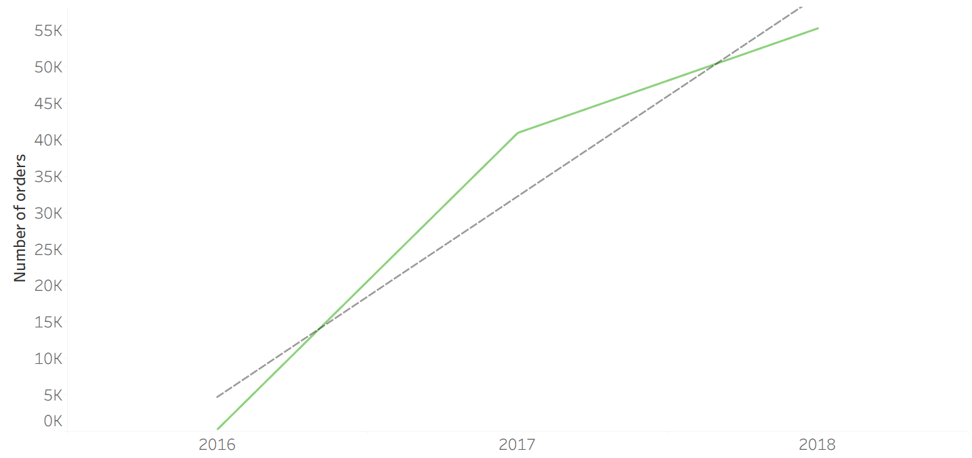
Magist User Growth Through Number of Orders
Notes:
We discovered a user growth, demonstrating a steady upward trend which shows a indication for an rising marketvalue.

Slide 3
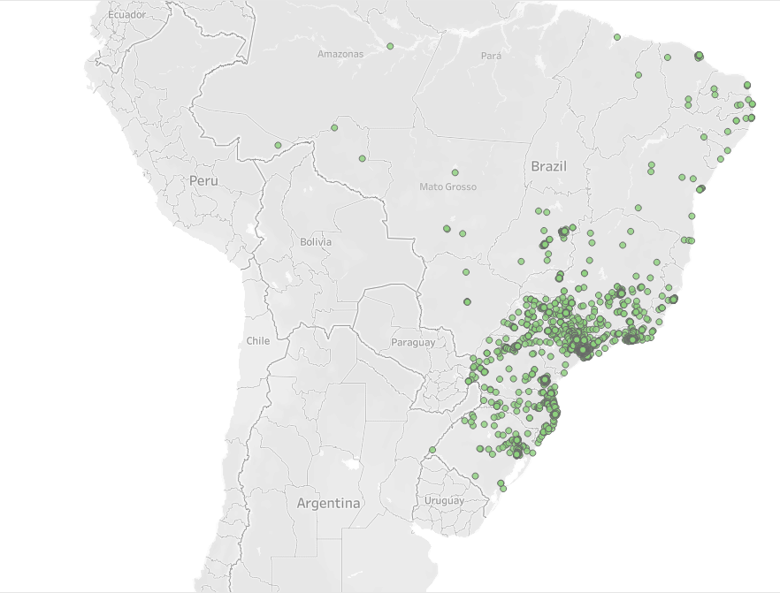
Magist: Sellers Locations
Notes:
Magist is apparently not used to handle hight priced items.
Most of the sellers are concentrated in central areas. This concentration could make logistics outside these regions more difficult or slower, so broader coverage is needed. This distribution should reduce the average delivery time, but it doesn’t.

Slide 4
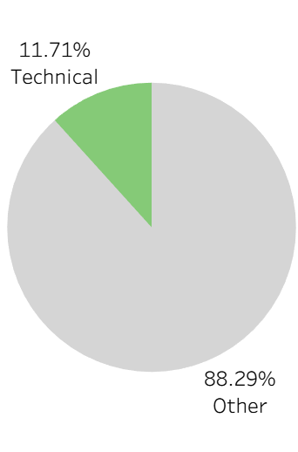
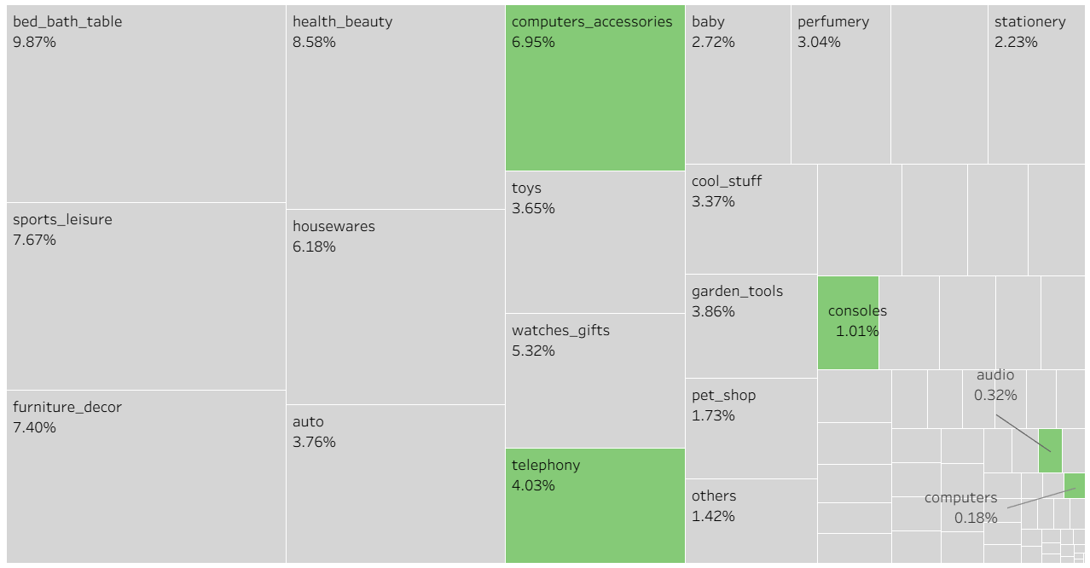
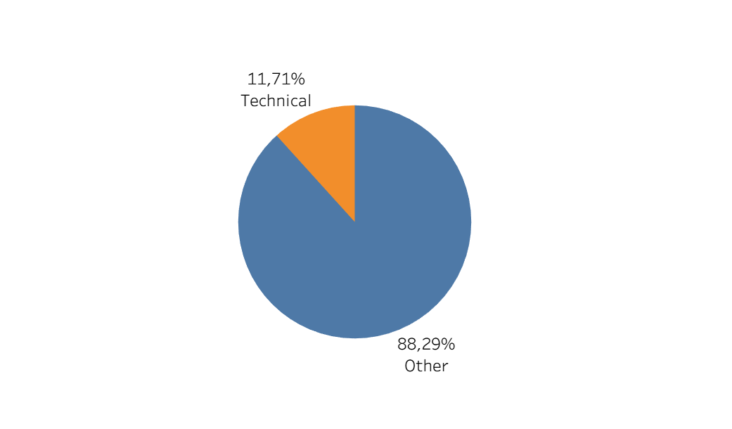
All Available Product Categories
Notes:
Our target categories are highlighted in green color, which are 12% in total sales.
We are not seeing a small deviation here, but a factor of 5x. This means that Magist mainly sells accessories, inexpensive gadgets, and entry-level devices, but hardly any high-end electronics.

Slide 5
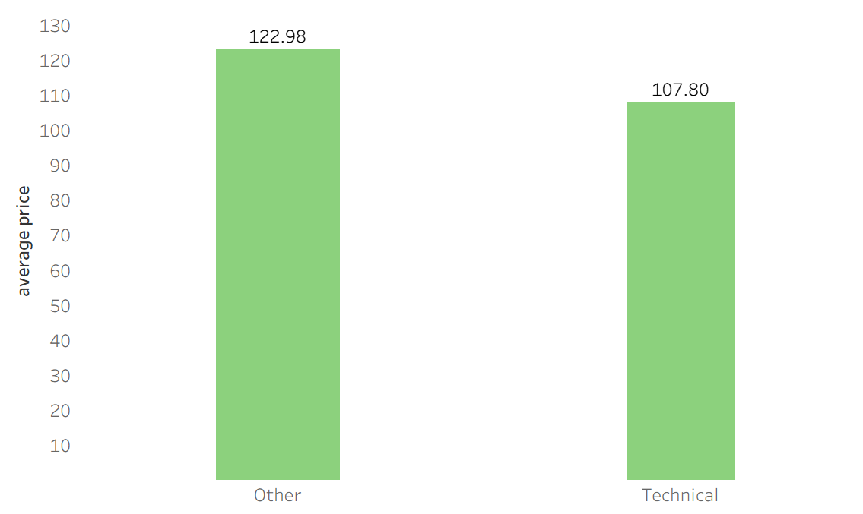
Average Price of Technical vs Non-Technical Items
Notes:
As you can see, the overall average price is quite low, and it is even lower in our specific categories. There is a huge discrepancy between these market figures and our internal numbers. Maria will now go into detail on why this difference exists.

Slide 6
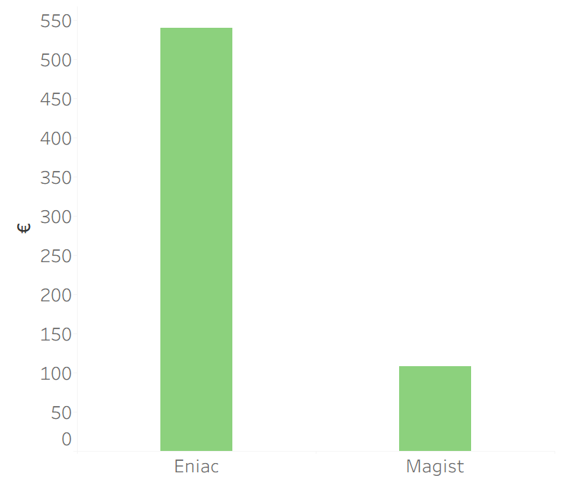
Magist Average Price of Tech Products vs Eniac’s
Eniac = 540,00€
Magist = 107,80€
Notes:
There is a massive discrepancy in the average price of tech products. While Eniac's products average €540.00, Magist sells products for an average of only €108
here we encounter a fundamental problem. Take a look at the figures: at Eniac, our average order value is €540. That's the world of iPhones and MacBooks. Magist, on the other hand, operates in a completely different reality. The average shopping cart there is only €108. So we are trying to sell luxury goods via a platform that is designed for inexpensive mass-market goods and small accessories.

Slide 7
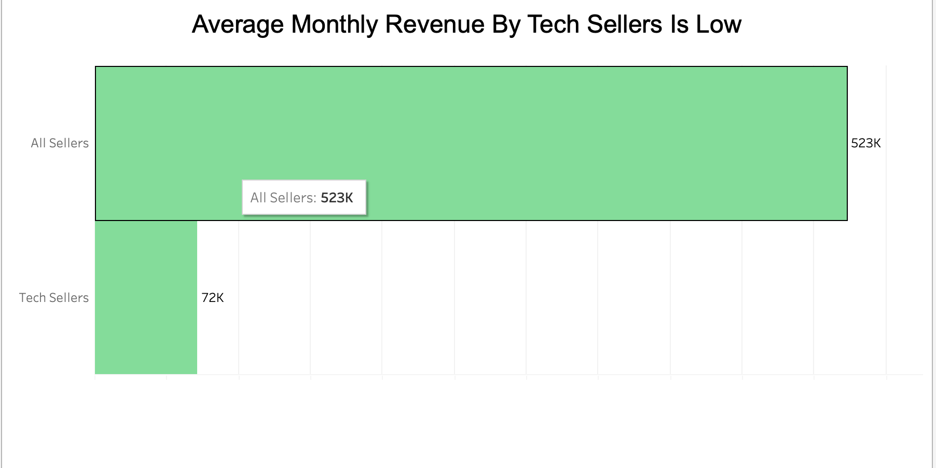
Average Monthly Revenue By Tech Sellers Is Low
Eniac → 1.17M €
Notes:
Eniac average monthly revenue is 1.17M€
The average monthly revenue of tech sellers on Magist is considered low, while Eniac's is €1.17 million.
Use “k” instead thousand

Slide 8

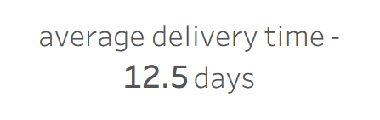

Slide 9
Conclusion
Magist isn’t used to handle high-end products.
Long delivery times, not representing our standard.
Still offers smooth expansion into Brazilian market →
One year probation contract instead of three years.
Shorter duration reduces risk.

Slide 10
Appendix

Slide 11
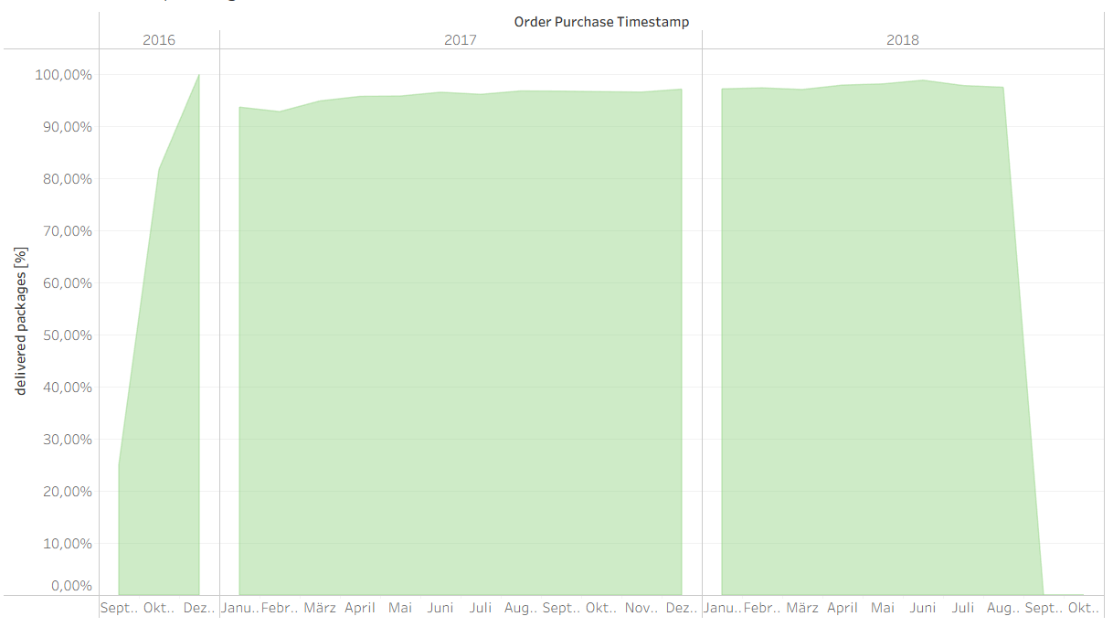
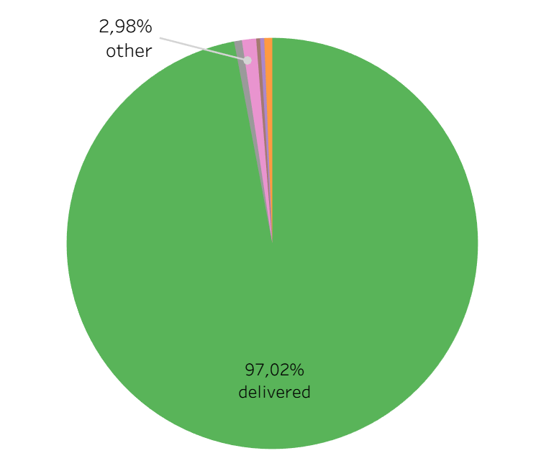
Delivered packages

Slide 12
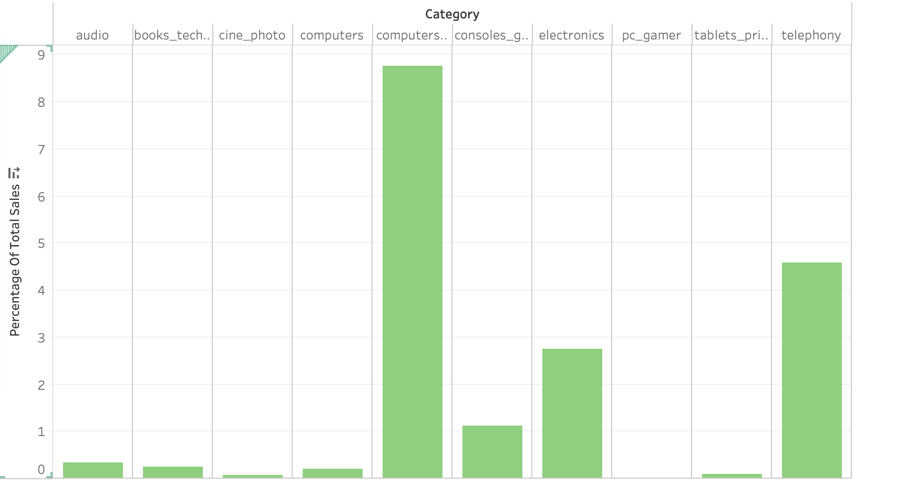
Percentage Share of Tech Categories in Total Sales

Slide 13
